Slide 1



EXPERT SYSTEM FOR DIAGNOSIS

Slide 2

GROUP MEMBERS:
Rawan Alsahafi | 2005794
Raneem Aljadani | 2006786
Asma Alghamdi | 2006380

Slide 3


1- Project Idea
2- Flow chart
Topics Covered
3- Pseudocode
4- Code
5- Output
6- References

Slide 4

Project Idea
Development Environment:
swish
Language:
prolog
Used AI Approach:
expert system

Slide 5
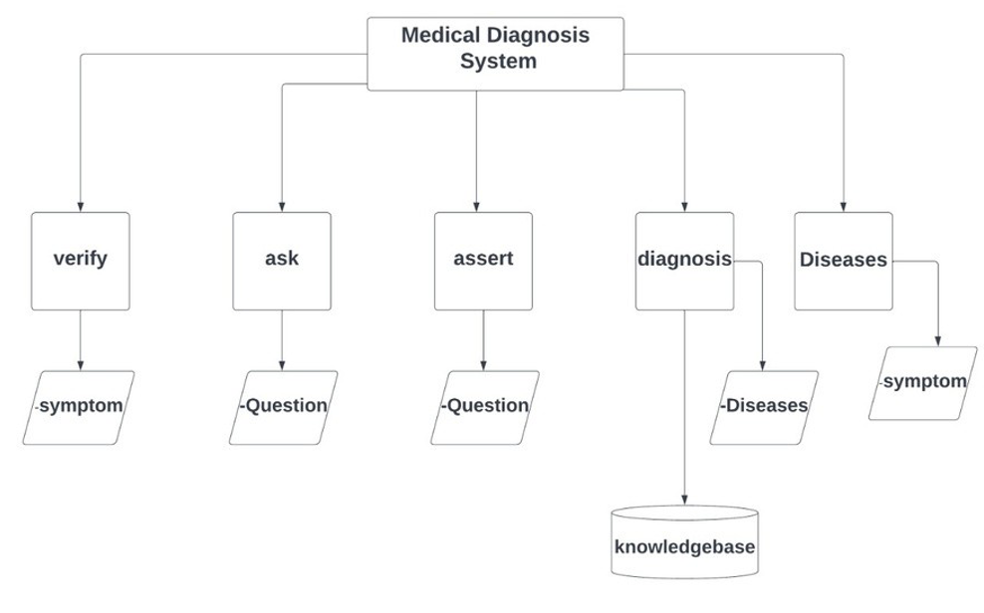
Flow Chart

Slide 6
This system ask the user questions about symptoms and records the answers, to diagnose the disease. it use its identification rules to determine the disease you have.
if a Question is asked && the answer is 'y' or 'yes', Then
assert 'yes(Question)',
else if answer is 'n' or 'no', Then
assert 'no(Question)' and failing.
else
write "Invalid Input!!!"
To verify symptoms
if 'yes(S)' has been stored, Then
succeed.
Else if 'no(S)'has been stored, Then
failing.
Else
ask(S).
pseudocode

Slide 7

CODE

Slide 8
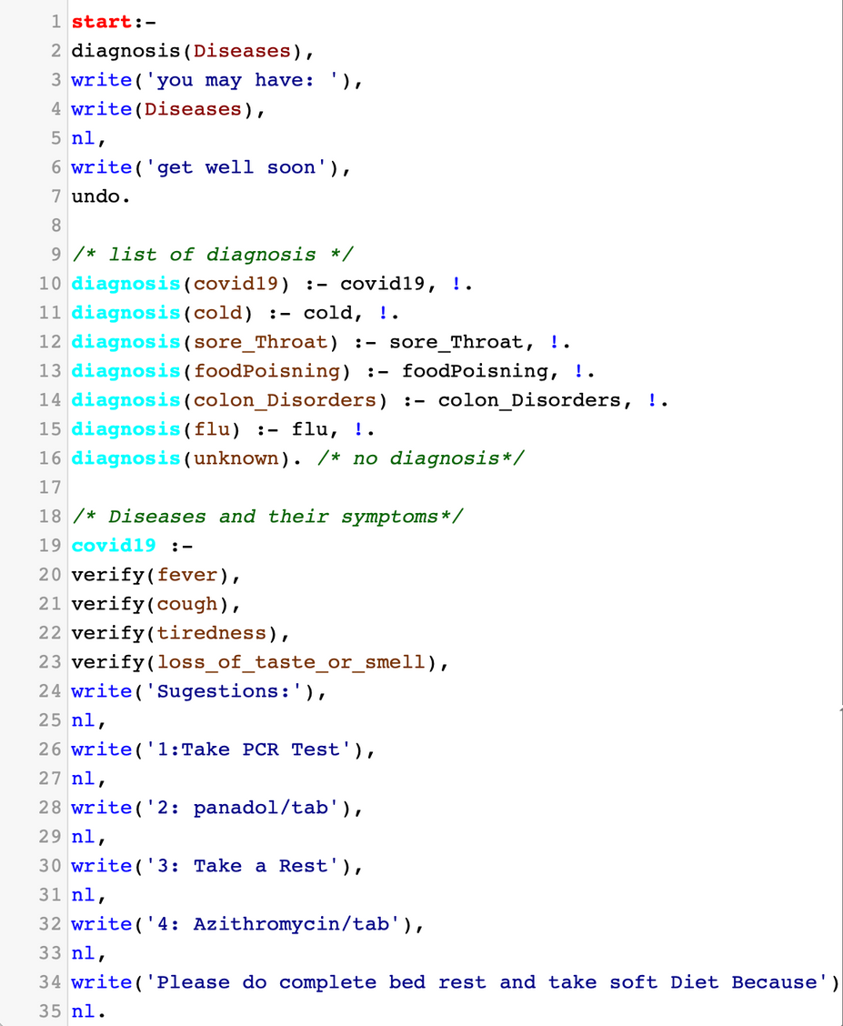
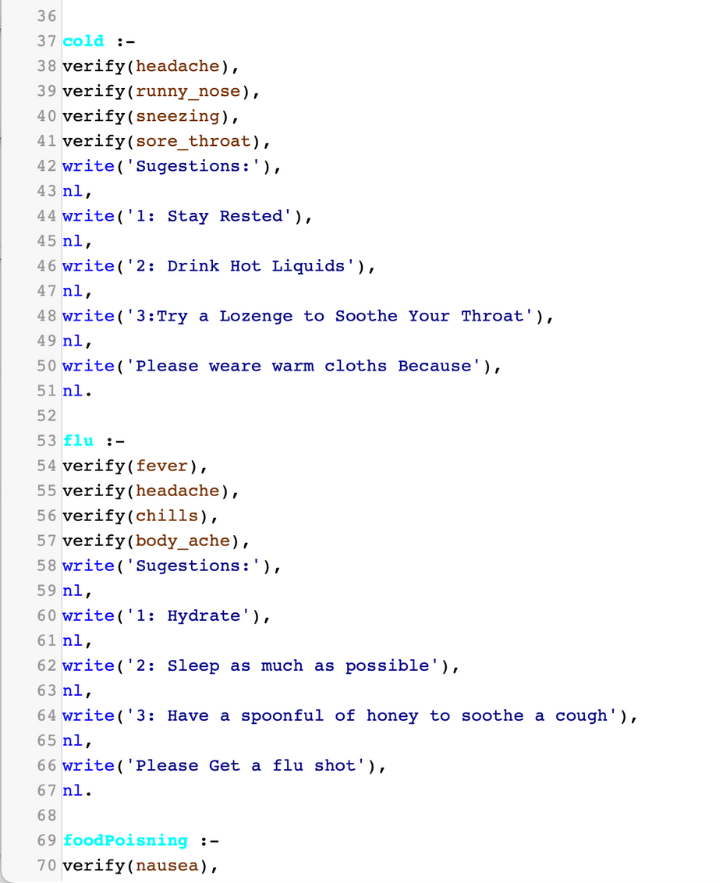

Slide 9
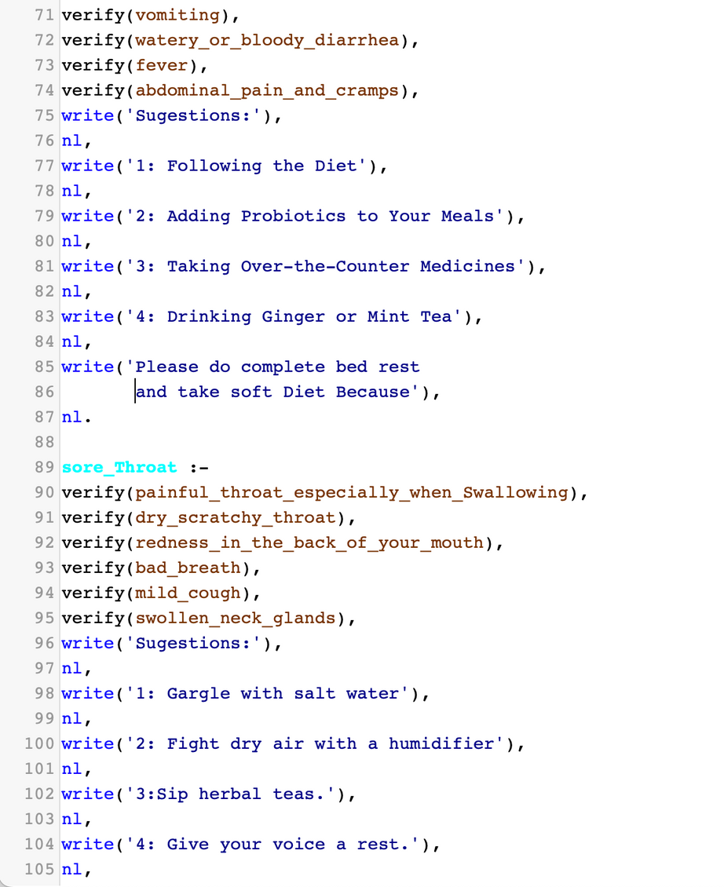
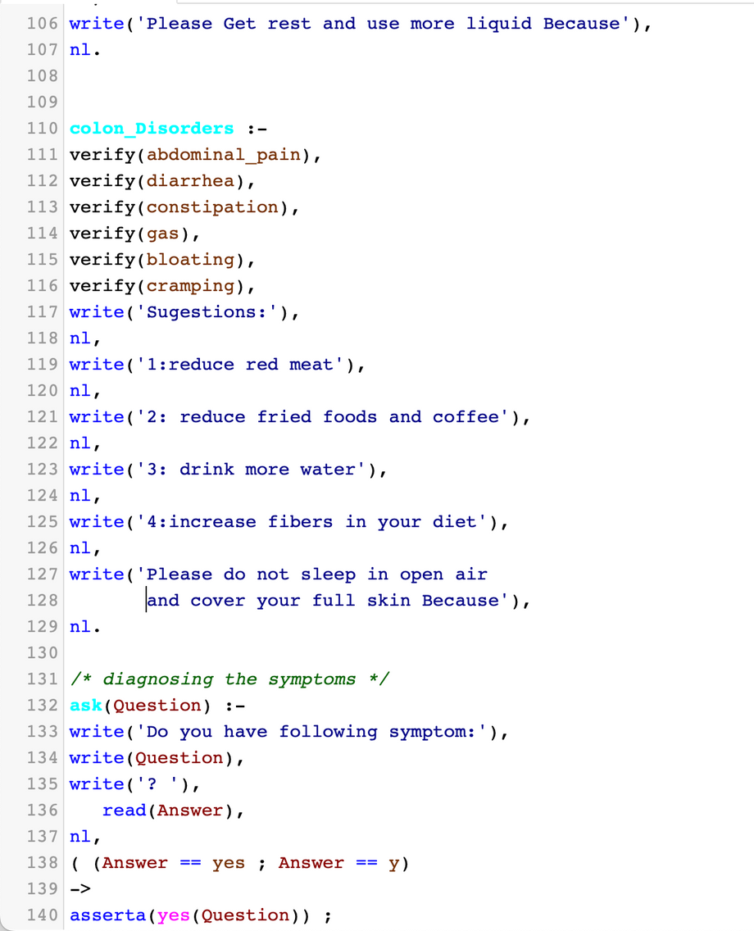

Slide 10
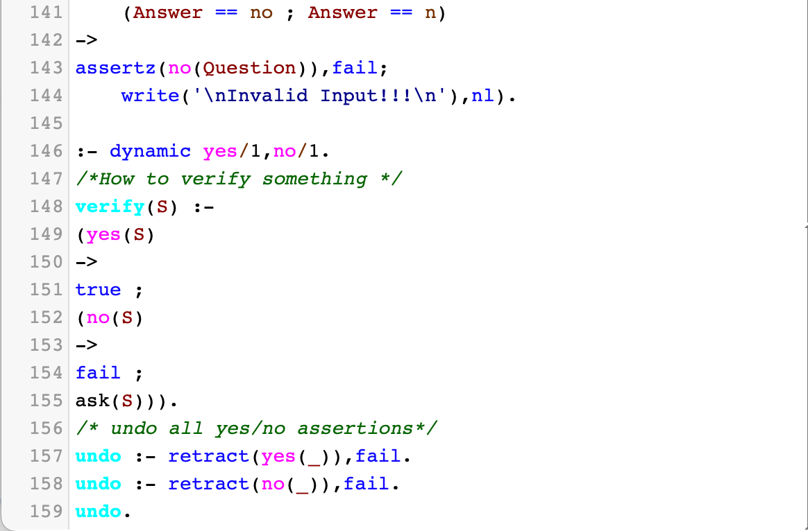

Slide 11

OUTPUT

Slide 12
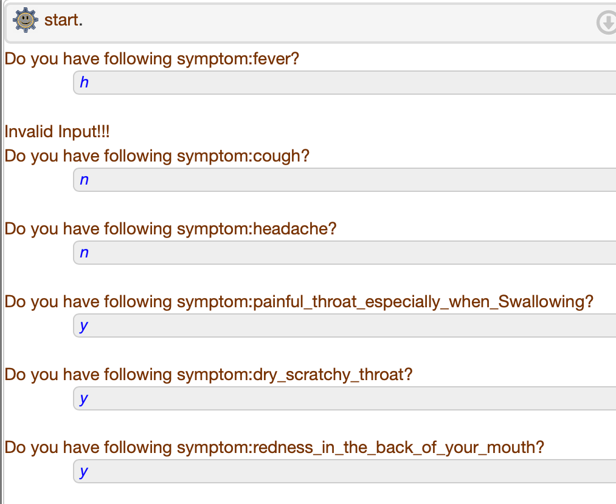
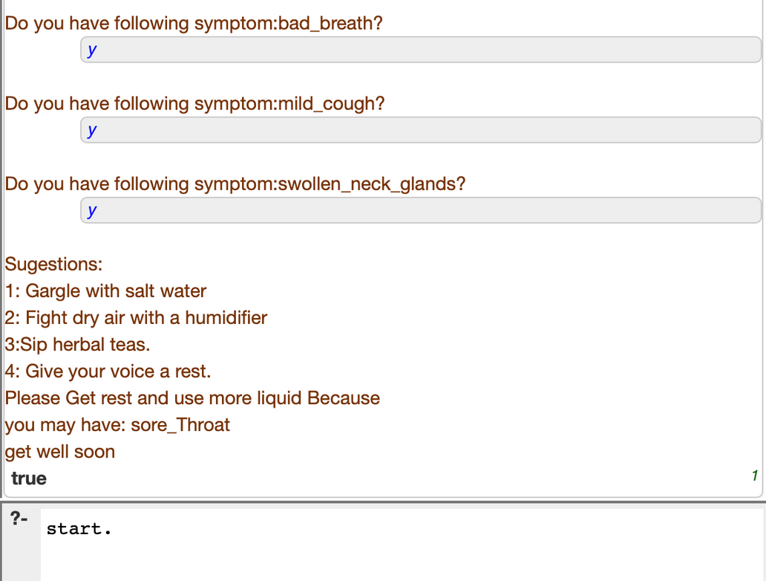

Slide 13
References
- Artificial Intelligence: A Modern Approach https://lms.uj.edu.sa/bbcswebdav/pid-1708687-dt-content- rid-13809016_1/xid-13809016_1
-Mayo clinic organization https://www.mayoclinic.org/
-Expert Systems Examples https://youtu.be/JYsC7Y_t410
-Tech target network https://www.techtarget.com/searchenterpriseai/definition/ex pert-system
-Artificial Intelligence: How is It Changing Medical Sciences and Its Future? https://www.ncbi.nlm.nih.gov/pmc/articles/PMC7640807/

Slide 14
Thank you!

